Slide 1



Web Accessibility Awareness,
Document & Image Accessibility
Notes:
Welcome to the State of Missouri Web Accessibility Awareness and Word Document Accessibility course, brought to you by Missouri Assistive Technology and the Office of Administration - Information Technology Services Division

Slide 2
Target Audience for Course
All State of Missouri Employees
Focus on those who create web content or documents for State of Missouri websites, social media platforms and intranet sites
Notes:
The target audience for this course is all State of Missouri Employees, with a Focus on those who create web content or documents for State of Missouri websites, social media platforms and intranet sites

Slide 3
Agenda
Module 1: What is Web Accessibility and Who Is It For?
Module 2: Assistive Technology & Examples
Module 3: Accessibility Law, Standards and the POUR Concept
Module 4: Document Accessibility
Module 5: Image Accessibility
Module 6: Summary, Next Steps & Being an Accessibility Champion
Notes:
The course will be divided into 6 modules:
Module 1: What is Web Accessibility and Who Is It For?
Module 2: Assistive Technology & Examples
Module 3: Accessibility Law, Standards and the POUR Concept
Module 4: Document Accessibility
Module 5: Image Accessibility
Module 6: Summary, Next Steps & Being an Accessibility Champion

Slide 4
Module 1:
What is Web Accessibility and Who Is It For?

Slide 5

What is Web Accessibility?
Physical “Curb Cut”
The practice of creating usable and understandable websites, applications and digital documents for ALL people.
Digital “Curb Cut”
Notes:
Web Accessibility, also known as digital accessibility is the practice of creating usable and understandable websites, applications and digital documents for ALL people.
Think of it as the ‘digital or electronic’ version of what you know as a multi-purpose sidewalk curb cut. As we step through the different lessons, you will see the far-reaching impact implementing web accessibility has.

Slide 6
Who is
Web Accessibility
For?
1 in 4
(28.7%)
American Adults
(73.4/244.5 million)
Adults identifying as having
some type of disability
Almost 1 in 3
(31.3%)
Missouri Adults
(1.5/4.65 million)
Data from: CDC Disability and Health Data Systems
Notes:
The primary audience is adults identified as having some type of disability. This affects 1 in 4 American adults (73.4 million) and almost 1 in 3 Missouri adults (1.5 million).

Slide 7
Think About the Impact…
If you were to exclude 1.5 million Missouri citizens from accessing websites, it would be like blocking access to Kansas City and the surrounding area (20 total counties).
Data from: CDC Disability and Health Data Systems
Notes:
Think about the impact from a Missouri perspective.
If you were to exclude 1.5 million Missouri citizens from accessing state websites and online services, it would be the equivalent of blocking access to Kansas City and the surrounding area (20 western and west-central Missouri counties). With our primary responsibility being public service, this would not be acceptable for very long.
These twenty counties have varying populations and are located in the West and West-Central portion of the state.
This example include: Buchanan, Clinton, Caldwell, Livingston, Platte, Clay, Ray, Carroll, Jackson, Lafayette, Saline, Cass, Johnson, Pettis, Cooper, Bates, Henry, Benton, Morgan and Moniteau Counties!

Slide 8




Disability Types
Visual Impairments
Blind, Low Vision, Colorblind, Glasses/Contact Users
Hearing Impairments
Deaf, Hard of Hearing, Hearing Aid Users
Motor Disabilities
Physical Weakness/Limitation
Cognitive/Learning Disabilities
Affects Processing of Information
Notes:
So when we are talking about disability, what are the kinds of disabilities?
Visual Impairments
Blind, Low Vision, Colorblind, Glasses/Contact Users
Hearing Impairments
Deaf, Hard of Hearing, Hearing Aid Users
Motor Disabilities
Those with Physical Weakness/Limitation
Cognitive/Learning Disabilities
Affects how information is processed
These users will use various devices, software and methods to interact with your content. Next, we will talk about what devices and software, called Assistive Technology, are used by these different disability types.

Slide 9

Cognitive & Learning
Examples:
Attention deficit hyperactivity disorder (ADHD)
Autism
Dyslexia
Learning disabilities like reading comprehension
Brain injury
Aging
Notes:
Let’s talk about cognitive and learning disabilities in a bit more detail. This category can be misunderstood or overlooked when incorporating accessibility
Examples include:
Attention deficit hyperactivity disorder (ADHD)
Autism
Dyslexia
Learning disabilities like reading comprehension
Brain injury
Aging

Slide 10
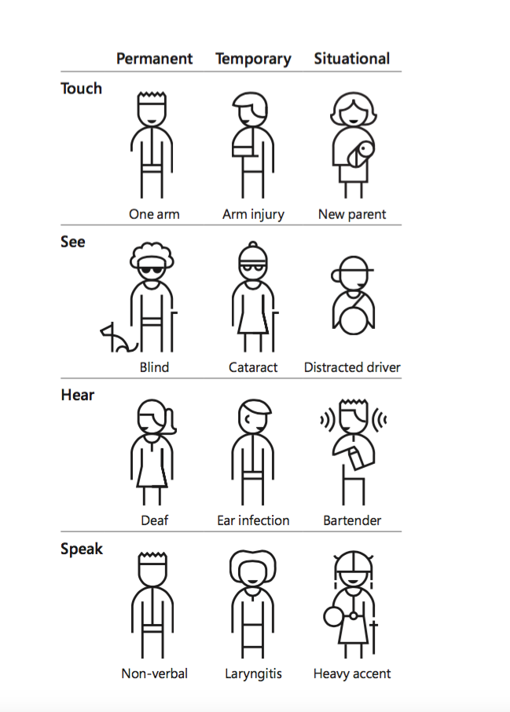
Did You Know?
Effective web accessibility positively affects everyone!
Users with temporary and situational disabilities
also benefit from accessible websites!
Notes:
The primary target audience for web accessibility guidelines and laws are providing equal access for those with permanent disabilities. But did you know? Effective web accessibility positively impacts everyone!
Users with temporary and situational disabilities also benefit from accessible websites!
Here are temporary and situation disabilities we can all relate to:
Mobility challenges like an arm injury or being a new parent holding a baby
Sight challenges like cataract vision loss or distracted driving
Hearing challenges like an ear infection or working in a loud environment
Speech challenges like laryngitis or someone with a heavy accent
These examples can help everyone better understand these challenges

Slide 11
Module 2
Assistive Technology
& Examples

Slide 12
What is Assistive Technology?
It’s common for those with disabilities to use assistive technology
“Assistive Technology is any tool, device, or product that helps people with disabilities perform tasks that they might not be able to do without it.”
Notes:
First let’s define Assistive Technology.
“Assistive Technology is any tool, device, or product that helps people with disabilities perform tasks that they might not be able to do without it.”

Slide 13

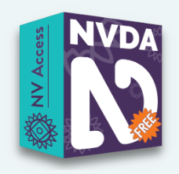


Visual: Blind
Screen Readers (Narration Software)
Screen readers are used to navigate a website by reading out loud what is on the screen to the user.
Used in combination with a keyboard or braille display, but not a mouse.
Voiceover
Notes:
Blind users are the primary users of screen readers (also known as narration software). Screen readers are used to navigate a website by reading out loud what is on the screen.
They are used in combination with a keyboard or braille display, but not a mouse.

Slide 14


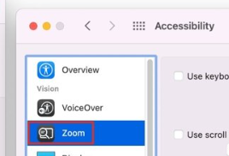

Visual: Low Vision
Screen Magnification
Magnification programs help the user enlarge everything that is found on the screen.
Windows Magnifier
Apple Zoom
ZoomText and JAWS
Notes:
Low vision users use screen magnification software. Magnification programs help the user enlarge everything that is found on the computer screen while maintaining clarity in the magnification, and they also increase color contrast and provide options of visual themes that make the screen readable (i.e. white fonts on black background, yellow on blue, or gray color scales/low contrast for migraines, etc.).

Slide 15
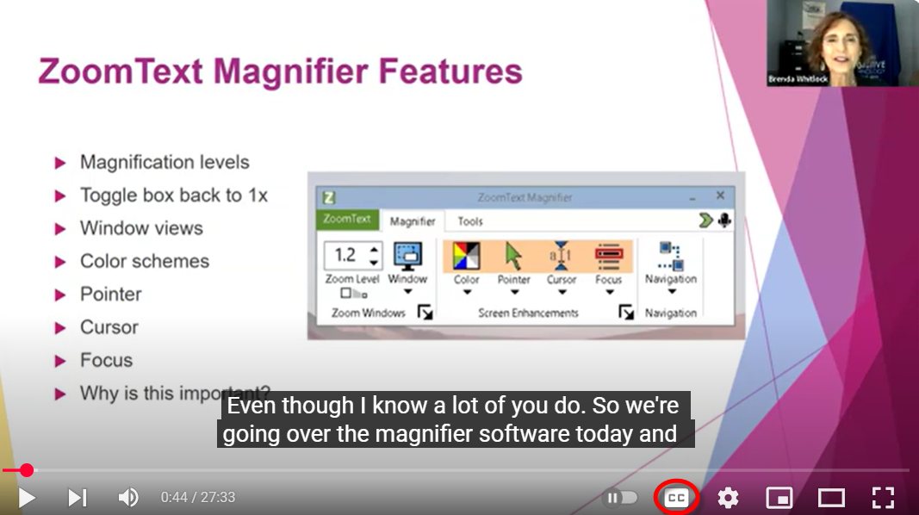
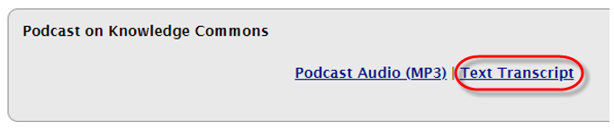
Deaf & Hard of Hearing
Closed captioning of videos and text transcripts of audio-only content allow users to read information that would otherwise be inaccessible.
Notes:
Closed captioning of videos and text transcripts of audio-only content allow deaf users to read information that would otherwise be inaccessible.
For example, closed captioning can be enabled in this YouTube video example. Major video platforms even allow you to automate this captioning. Keep in mind, reviewing the captioned text for accuracy is important.
In this next example, we have a link to a podcast episode, followed by a text version transcript.
This can be useful for those that are hearing impaired as well as for those people who do not process information verbally/orally. For some who have information processing disabilities or for presenters who have strong accents, being able to read and listen to content at the same time increases their understanding. Text based transcripts also give you the ability to key word search for specific content in the video or audio file.

Slide 16
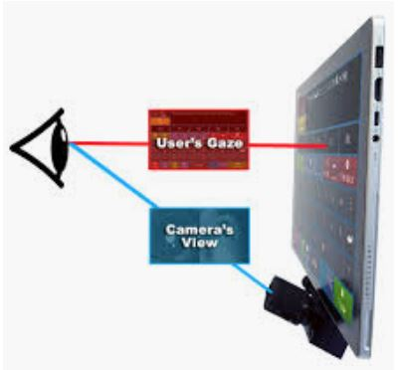
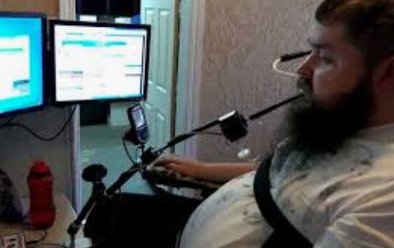

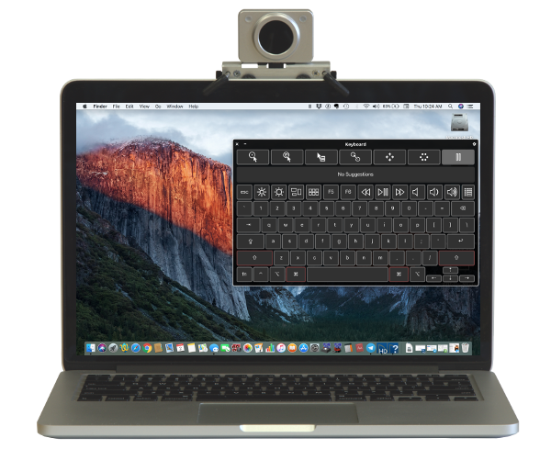
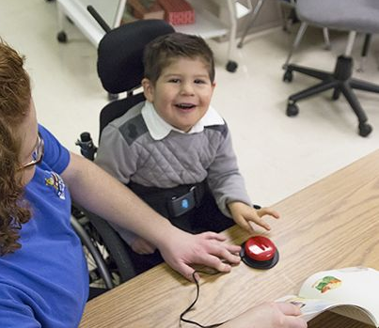
Motor & Physical Disabilities
Motor or physical disabilities are weakness and limitations of muscular control
Eye Gaze Technology
Mouth Movement
Speech to Text
Head Mouse
Switch
Notes:
Motor or physical disabilities are weakness and limitations of muscular control.
Because of this, users will use alternative devices in place of a standard keyboard and mouse.
In the examples here, eye gaze technology uses eye movement, head mouse uses head movement, and a mouth joystick uses mouth movement to interact with content.
A switch is another type of mouse/keyboard alternative that uses an onscreen keyboard in combination with a physical input (the switch).
Speech to Text software is another great tool for those with mobility issues.
These devices help those with severe physical limitations, like muscle control, as well as missing limbs. Creating accessible content for these types of assistive devices helps those with both severe physical limitation as well as assist people with more mild physical impairments such as arthritis in the hands.

Slide 17
Cognitive & Learning
Impacts how people process information
Users will:
Navigate web content using different strategies
Access information using speech-to text, screen readers, captions or other formats
Change the presentation of the content according to needs and preferences
Content creators can:
Use plain language at 6th-8th grade reading level
Include white space between major thoughts or important points
Use bulleted or numbered lists to simplify content
Notes:
Let’s discuss common ways those with cognitive disabilities may process your information differently.
Users will:
Navigate web content using different strategies
Access information using speech-to text, screen readers, captions or other formats
Change the presentation of the content according to needs/preferences
What can you do as a content creator to make content more easy to understand?
Use plain language at 6th-8th grade reading level
Include white space between major thoughts or important points
Use bulleted or numbered lists to simplify content

Slide 18
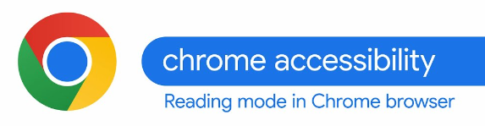
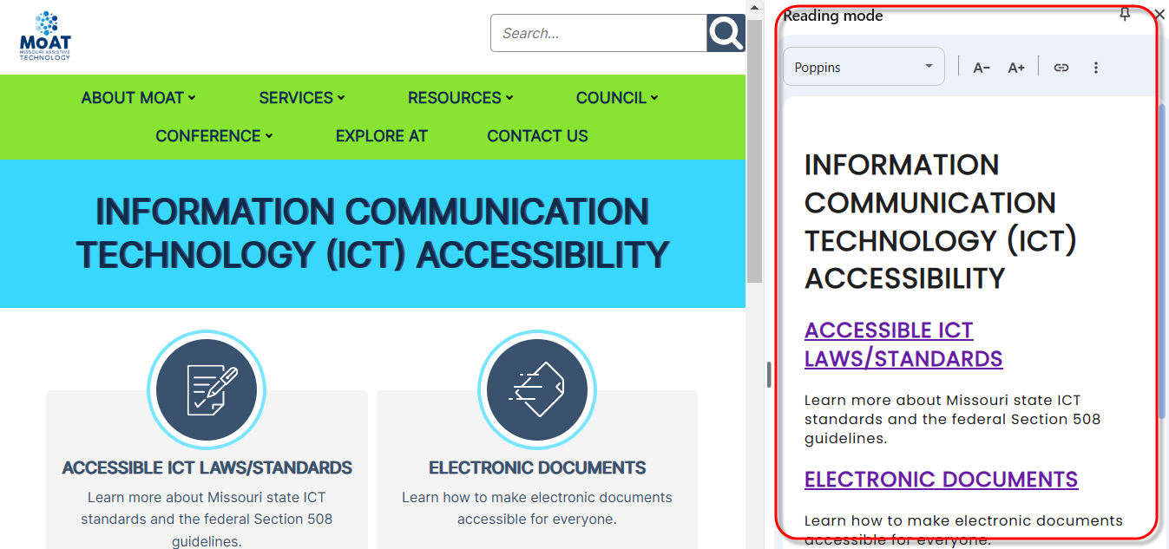

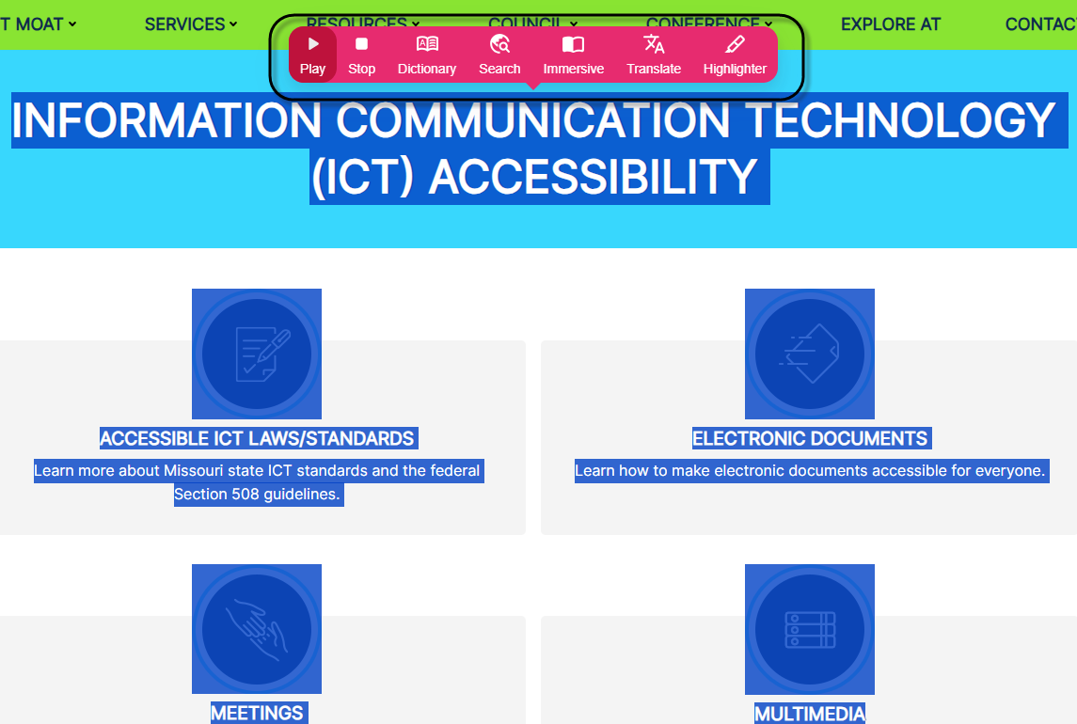
Cognitive & Learning Tool Examples
Chrome Reading Mode located under Chrome Settings – More Tools
Helperbird Browser Extension
Notes:
Here are examples of tools that can improving cognition and learning.
In this first example, we see a Chrome browser feature called the Chrome Accessibility Reading Mode. It can remove distracting menus and images for easier reading.
In this second example, we have a Chrome extension called Helperbird, which can read aloud content on the page, readability features like text spacing, text sizing or increasing contrast as well as simplified reading modes.

Slide 19
Module 3
Accessibility Law, Standards and the POUR Concept

Slide 20
Federal Laws
Rehabilitation Act of 1973
Section 504
Federally funded govt. agencies and projects, postsecondary institutions (2024 Update)
Section 508
Federal government
Americans with Disabilities Act
Title II
State and Local Government (2024 Update)
Individuals with Disabilities Education Act (IDEA)
Notes:
These are the laws that include web accessibility language
Section 504 prohibits discrimination against people with disabilities in programs that receive federal funding. It affects programs and activities in public education, healthcare, and transportation.
Section 508 of the Rehabilitation Act of 1973 requires that federal agencies make their technology communications accessible to all people. This was the first law to include web accessibility language.
Title II of the ADA requires state and local governments to make sure that their services, programs, and activities are accessible to people with disabilities.
IDEA ensures that children with disabilities receive a free and appropriate public education.

Slide 21
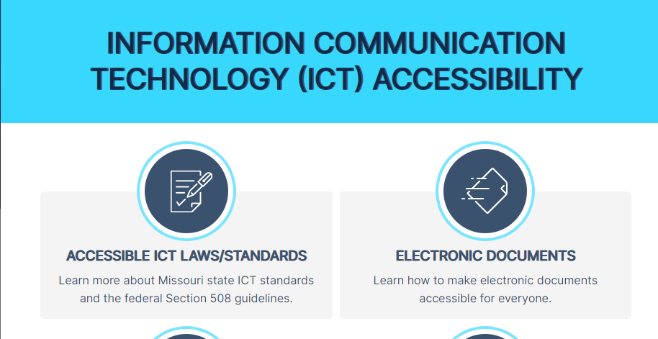
Missouri State Law
Missouri State Statute – effective 1999
Missouri State Standard – effective 2003
              Agency public sites
              Like accessing information about a local state park
                Web applications (interactive websites)
                Like applying for a job on https://jobs.mo.gov
                Contracted sites/licensed web software
                Contracted site like mocareers.mo.gov
                Licensed web software like Wufoo form creator
                Intranet sites
                Like accessing personnel policies on your agency’s intranet
                Social media content
                Like a Facebook post with image
Notes:
The state created a web accessibility statute in 1999, referencing the Federal guidance of section 508.
A state standards document soon followed in 2003, outlining what specific guidelines the state will follow (called the Missouri State Standard)
Examples of content covered by these laws include:
Agency public sites
Like accessing information about a local state park
Web applications
Like applying for a job on https://jobs.mo.gov
Contracted sites/licensed web software
Contracted site like mocareers.mo.gov
Licensed web software like Wufoo form creator
Intranet sites
Like accessing personnel policies on your agency’s intranet
Social media content
Like a Facebook post with image

Slide 22
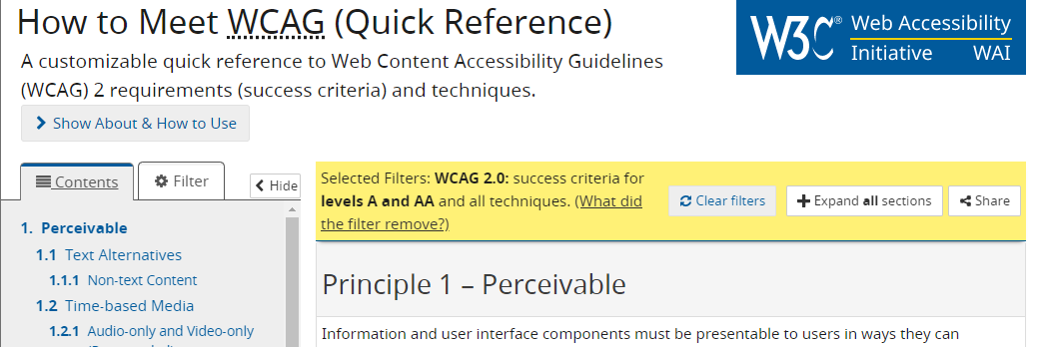
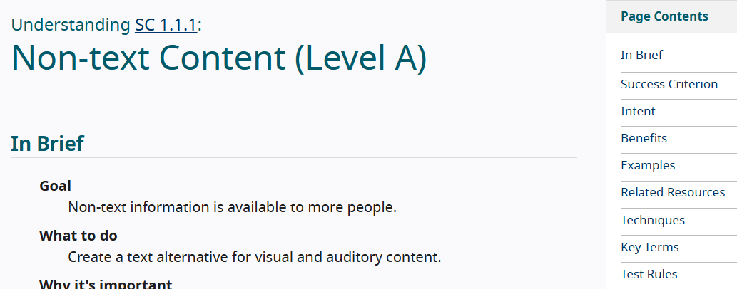
Missouri State Law
Web Content Accessibility Guidelines (WCAG)
International standard developed by the World Wide Web Consortium (W3C)
Each guideline includes a list of testable success criteria to help create accessible content.
Missouri Standard
WCAG Version 2.1 compliance began March 2025
WCAG Version 2.2 implemented October 2025, compliance deadline April 2026
Notes:
Web Content Accessibility Guidelines (WCAG)
International standard developed by the World Wide Web Consortium (W3C)
Each guideline includes a list of testable success criteria to help create accessible content. This makes it easy to check if something meets a specific standard.
Missouri follows WCAG in its standard document
WCAG Version 2.1 implemented September 2024, compliance deadline March 2025
WCAG Version 2.2 implemented October 2025, compliance deadline April 2026.

Slide 23
Accessibility Principles
P
O
U
R
Perceivable
Operable
Understandable
Robust
Users can identify content by way of sight, sound, and/or touch, regardless of device or operating system.
A website should work correctly whether visitors are using a mouse, a keyboard, voice commands, or other device.
Navigation and design should be predictable and consistent, content is written clearly and simply and tasks are easy to complete.
When content is well-designed/well-planned, it doesn’t matter what technology a citizen uses to access it.
Notes:
WCAG is organized under four guiding principles, called POUR
Each letter of POUR is part of this acronym and represents: P for perceivable, O for operable, U for Understandable and R for Robust.
Perceivable - Users can identify content by way of sight, sound, and/or touch, regardless of device or operating system.
Operable - A website should work correctly whether visitors are using a mouse, a keyboard, voice commands, or other device.
Understandable - Navigation and design should be predictable and consistent, content is written clearly and simply and tasks are easy to complete.
Robust - When content is well-designed/well-planned, it doesn’t matter what technology a citizen uses to access it.

Slide 24
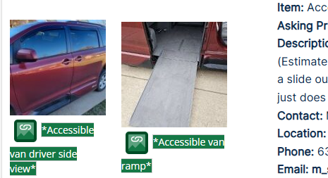
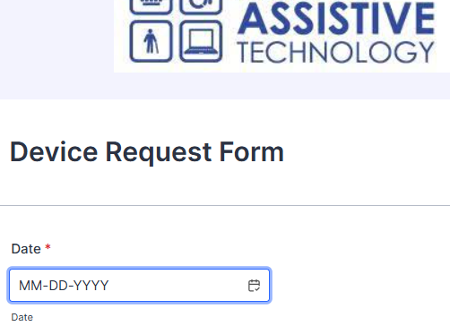
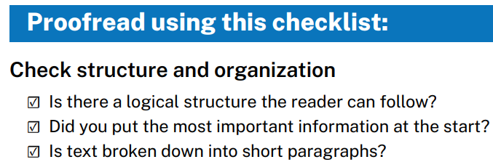
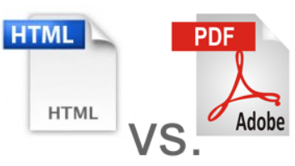
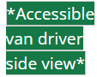

Accessibility Principles
P
O
U
R
Perceivable
Operable
Understandable
Robust
Review and apply accurate and descriptive alternative text for images (visual impairments)
People can fully operate your website or application using keyboard alone.(visual or motor impairments)
Review your content for clear and simple language using guides like the Plain Language Quick Reference Guide.
Webpage content is automatically more accessible versus formatting as a document. Ensure you have a need to offer content as a document/PDF.
Notes:
To better understand POUR, let’s review examples for each.
For Perceivable, an example would be to “Review and apply accurate and descriptive alternative text for images. This especially benefits those with visual impairments. We have an example here displaying alternative text for two images of a handicap accessible van, each describing different angles of the van. We will talk more about alternative text in Module 5, image accessibility.
Next is Operable. An example is that “People can fully operate your website or application using keyboard alone.(for visual or motor impairments)” The example shows a form field with a blue outline showing keyboard focus.
For Understandable, review your content for clear and simple language using guides like the Plain Language Checklist for Web. Below that is an image of some of the checklist items for Plain Language, including using logical structure, displaying the most important information at the beginning and grouping text into multiple smaller paragraphs.
Finally, Robust. The example here is that Webpage content is automatically more accessible versus offering content as a downloadable document. Make sure you have a specific need to offer content as a document/PDF.

Slide 25
Module 4
Document Accessibility Features

Slide 26
Document Accessibility Features
Text & Non-Text Color Contrast
Alternative Text for Images
Structured Headings
Structured Data Tables
Descriptive Hyperlinks
Descriptive Title within Document Properties
Other Accessibility Tips
Notes:
A majority of state employees create documents as part of their work. Many of these documents are posted on agency websites, intranet sites, or social media platforms. There are required accessibility features document creators need to consider.
These include:
Specific Color Contrast for Text and Images
Alternative Text for Images
Structured Headings
Structured Data Tables
Descriptive Hyperlinks
Descriptive Title within Document Properties
Other Accessibility Tips

Slide 27
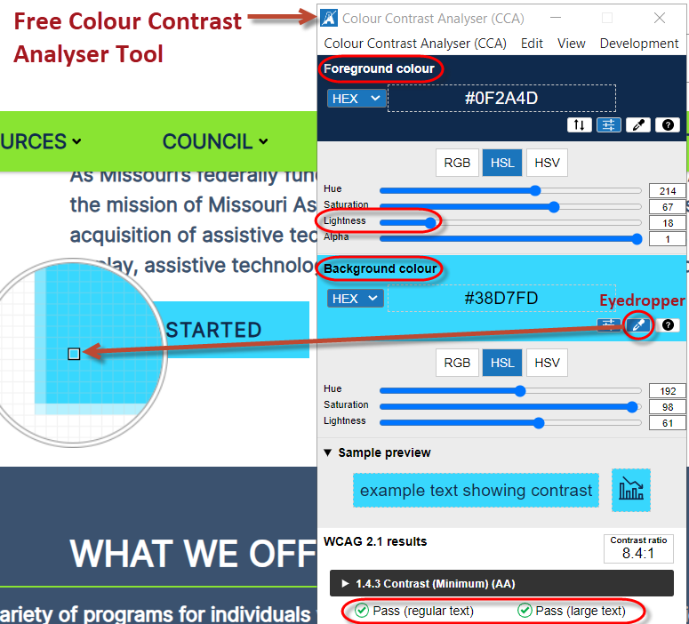
Text & Color Contrast
Contrast is a measure of the difference in perceived “luminance” or brightness between two colors.
Minimum 4.5:1 ratio for regular sized text
(<18pt+ or <14pt+ bold)
Minimum 3:1 ratio for large sized text
(18pt+ or 14pt+ bold)
Exception: Logos
Users impacted: Low vision, colorblindness, aging,
cognitive impairments, those in bright environments.
Free tools to test color contrast
Notes:
Color contrast is the ratio of the foreground text color and the background color
There is a Minimum 4.5:1 ratio for regular sized text
Minimum 3:1 ratio for large sized text
(large,sized text is considered 18pt+ or 14pt+ bold)
The one exception to this is text within Logos
Users impacted: Low vision, colorblindness, cognitive impairments
Tools to test color contrast are the Colour Contrast Analyser or WebAIM Contrast checker. These will give you feedback whether contrast passes or fails.
Refer to the resource links as part of this course.
This example is the color contrast analyser tool, you can pick your colors through the color dropper or grab the color code in the website style sheet. If your colors didn’t pass, you can adjust the lightness slider to find a passing color.

Slide 28
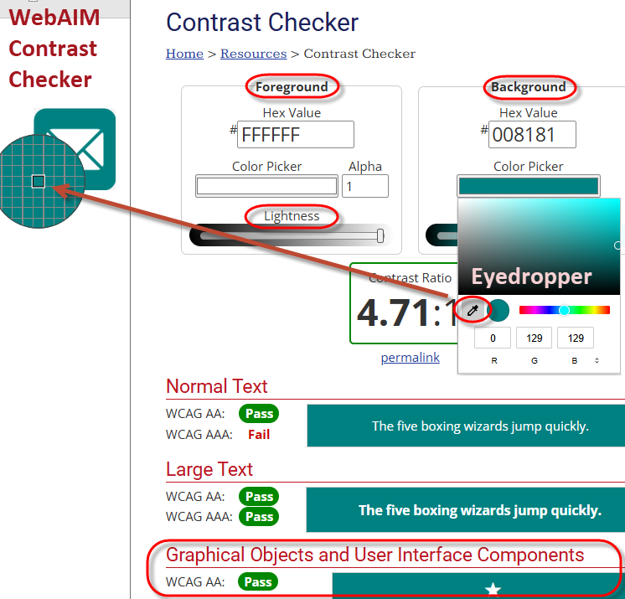

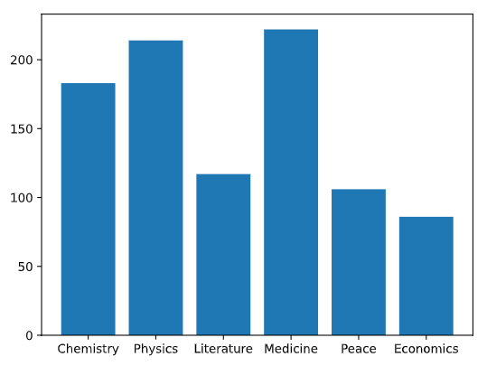

Non-Text Color Contrast
Non-text examples include:
                Form field outline or a checkbox
                Graphical object like a print icon button
                or bars in a bar chart
Minimum 3:1 Ratio
Notes:
There is also a color contrast standard for non-text elements. Examples include form input field outlines (like this search box), graphical objects (like this email icon button) or elements in a chart (like the blue bars in this bar chart). This type of contrast is equally important to text contrast for readability.
In this example to the right, we are using the WebAIM contrast checker. We checked the background color using an eye dropper, checking to see whether it passed under the “Graphical Objects Component” section. Had this color combination not passed, we could have adjusted the lightness slider to move it within a passing range, then used the new color to update the icon.
There will be further discussion on text and non-text color contrast in Module 5: Image Accessibility

Slide 29
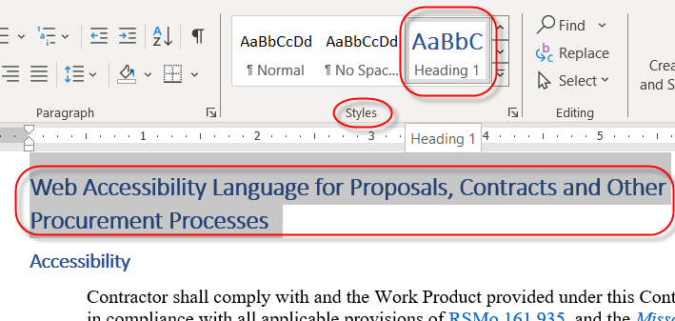
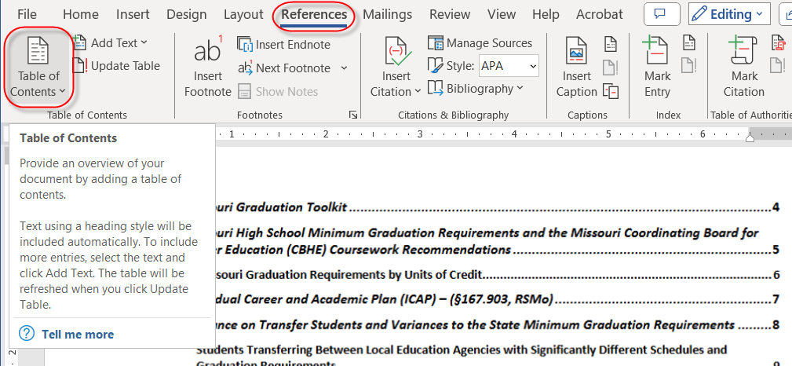
Heading Structure
Create a uniform heading structure through use of styles. This allows screen reader navigation.
This also gives the ability to quickly create a table of contents.
Notes:
Implement the use of styles to create a uniform heading structure.
Formatting text manually outside the styles menu will not add this needed structure. At minimum, identify a heading 1, the main document subject. When reviewing a document, if you see areas that are logically grouped with a subject title, convert those to a heading 2. Screen readers use headings to navigate content.
In the first example here, we are applying a heading 1 to the text at the top of this document, from the Home ribbon, under styles.
The added benefit of applying heading styles throughout your document is the ability to automatically add a table of contents at the beginning of your document, as you see here in this second screenshot. To insert a table of contents, go to Reference – Table of Contents. Applying headings styles will also creating handy bookmarks when converting your document to PDF.

Slide 30
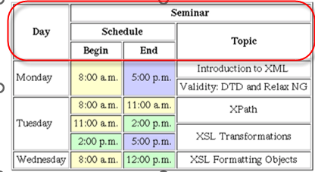

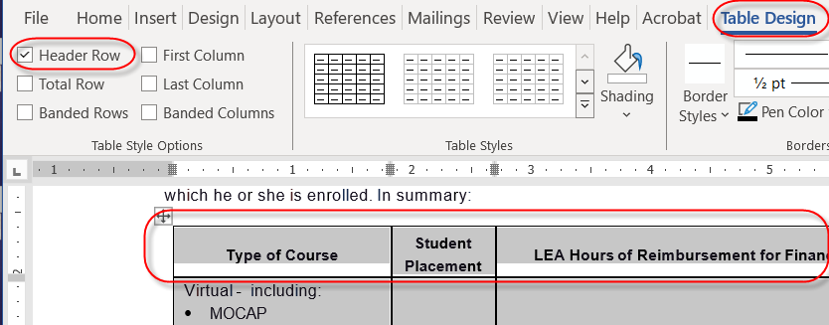
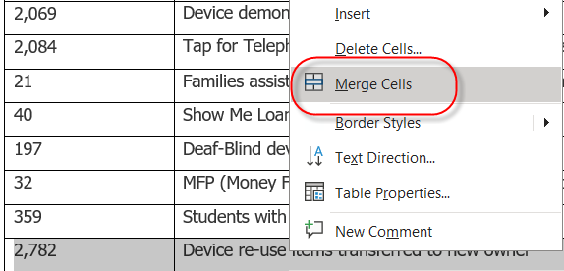
Data Tables
Accessible data tables need a clear table structure and table headers to help guide a screen reader user.
To add headers to the first row, highlight the table, select Table Design > Table Style on the ribbon, then choose the Header Row.
Avoid complex tables.
Avoid merging or splitting cells.
Avoid tables for layout purposes.
Notes:
Accessible data tables need a clear table structure and table headers to help guide a screen reader user.
To add headers to the first row, highlight the table, select Table Design > Table Style on the ribbon, then choose the Header Row.
Avoid using tables for layout purposes.
Be careful of using overly complex tables that have multiple nested column or row headers, there is no way to make these accessible in Word and challenging in a document converted to PDF. Here you see an example of a table with multiple column headers.
Evaluate complex tables to see if they can be divided into multiple tables.
Plan out tables carefully to avoid merging and splitting cells.

Slide 31
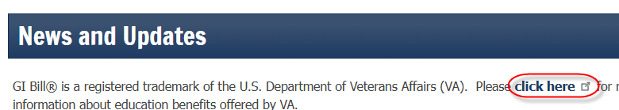
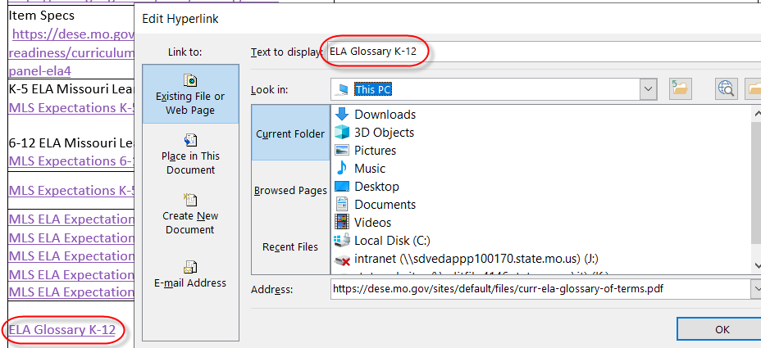
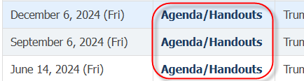
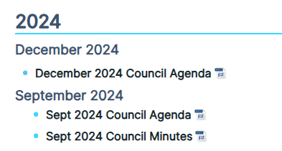

Descriptive Hyperlinks
Link text should convey clear and accurate information about the destination
Avoid “click here”, “more information”, or long web addresses
Create unique links (January 2024 Agenda vs. Agenda)
Notes:
Link text should convey clear and accurate information about the destination
Avoid “click here”, “more information”, or long web addresses as the links text.
Create unique links
Look at the three examples on the left. The first example shows a vague, click here link. The second examples shows repeated links of “Agenda/Handouts”.
In the third example, we show distinct, descriptive links for an agenda/minutes page. You will see that we include the month and year as part of the link description.
To the right, we show an example of how to set a link. Highlight the link, click link and paste in the link. You can also adjust your link text right here.
For print only handouts, use short, easy to type web addresses.

Slide 32
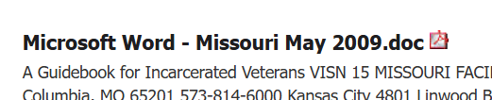
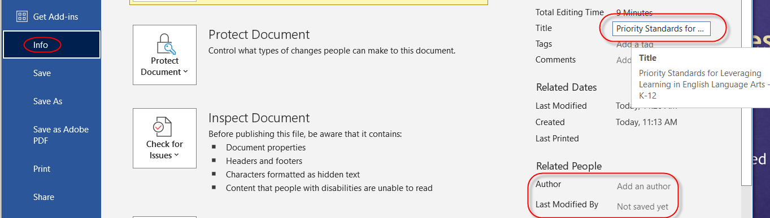

Document Properties - Title
File > Info
Add descriptive title for document
Review Author section to see if it needs to be deleted or updated
Notes:
Link text should convey clear and accurate information about the destination
Avoid “click here”, “more information”, or long web addresses as the links text.
Create unique links
Look at the three examples on the left. The first example shows a vague, click here link. The second examples shows repeated links of “Agenda/Handouts”.
In the third example, we show distinct, descriptive links for an agenda/minutes page. You will see that we include the month and year as part of the link description.
To the right, we show an example of how to set a link. Highlight the link, click link and paste in the link. You can also adjust your link text right here.
For print only handouts, use short, easy to type web addresses.

Slide 33
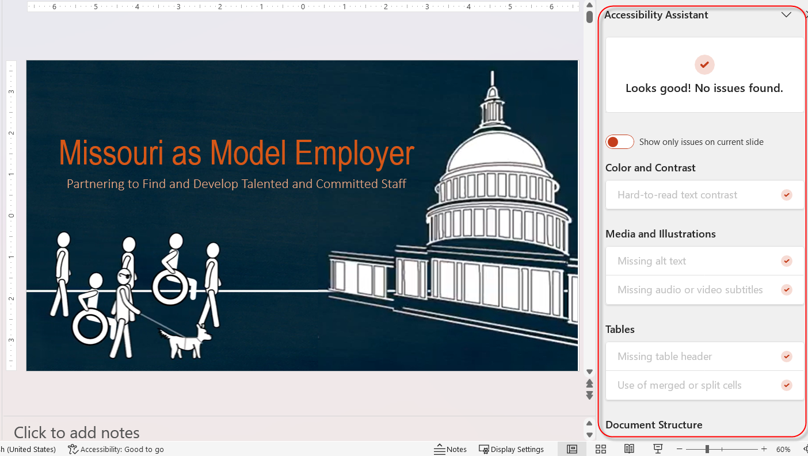
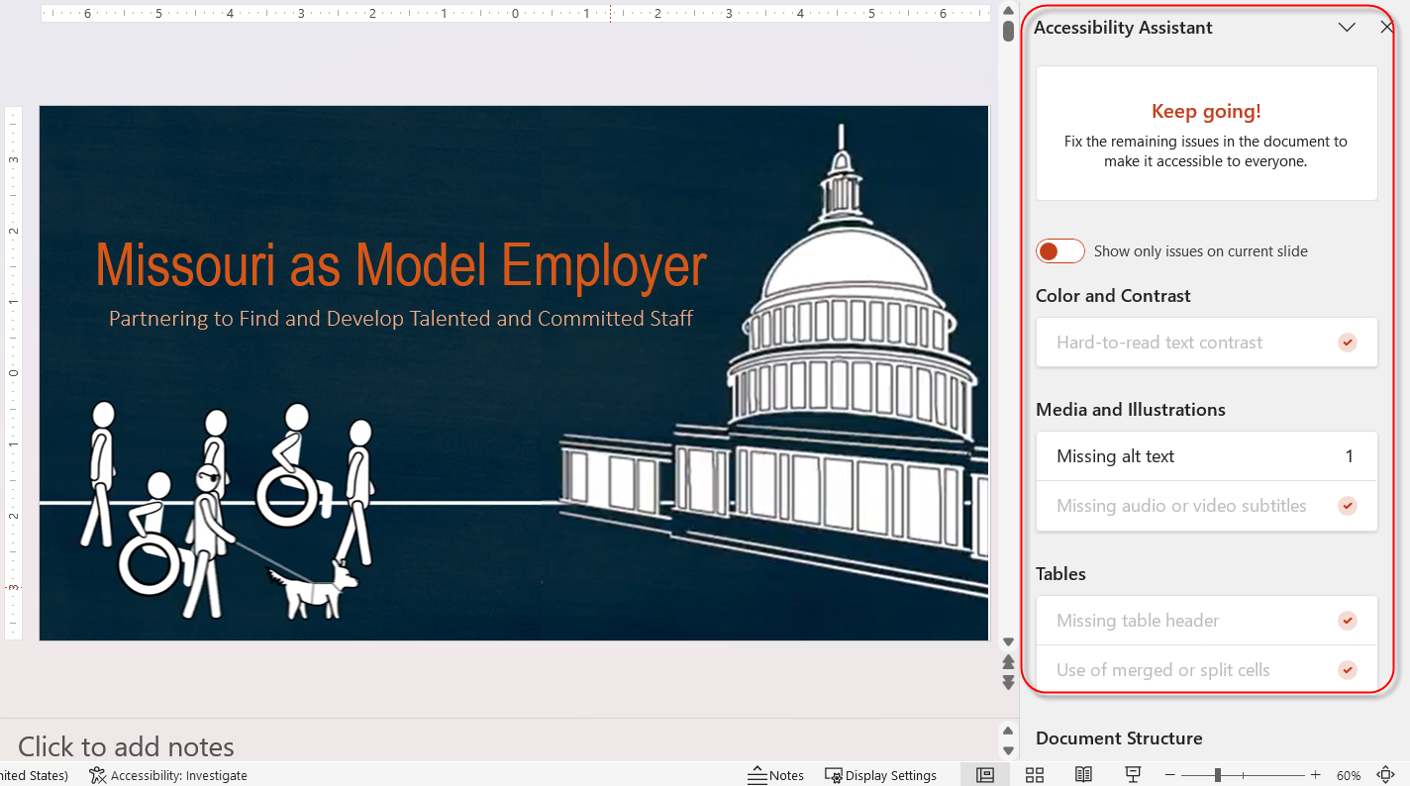


Microsoft Accessibility Assistant
Alert located in bottom task bar – Accessibility: Good to Go or Investigate
Checker does check: Text contrast, presence of alt text, table headers
Checker does not check: Image color contrast, vague link text, missing headings, missing document title
Notes:
Microsoft office tools include an accessibility assistant. The accessibility alert is located in the bottom task bar – identified as Accessibility: Good to Go or Investigate.
Another way to access the accessibility checker is under File – Info – Check for issues
The accessibility Checker does check: text contrast, presence of alt text, table headers
Checker does not check: Image color contrast, vague link text, missing headings, missing document title
Look at the three examples on the left. The first example shows a vague, click here link. The second examples shows repeated links of “Agenda/Handouts”.
In the third example, we show distinct, descriptive links for an agenda/minutes page. You will see that we include the month and year as part of the link description.
To the right, we show an example of how to set a link. Highlight the link, click link and paste in the link. You can also adjust your link text right here.
For print only handouts, use short, easy to type web addresses.

Slide 34
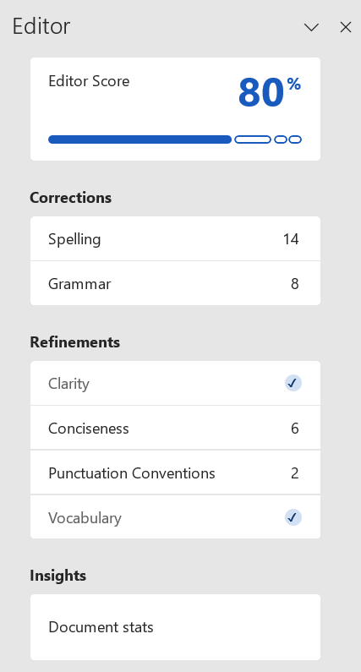

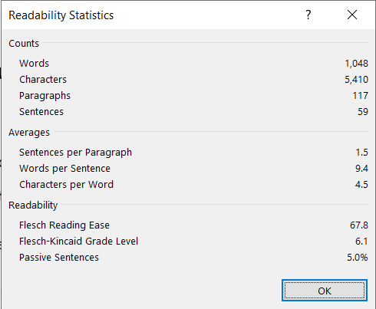
Plain Language
Use plain language (plain writing) to better manage “cognitive load”
Recommended 6th-8th grade reading level for most content
Identify your audience
Keep content meaningful and to the point
Keep sentences as short as possible and paragraphs
2-3 sentences
Use active voice, not passive voice
Use common, everyday words, using a conversational style
Organize information -- important information first and use headings for easy scanning
Simplify content with bulleted/numbered lists and simple data tables
Ask others to review your content for feedback
  Review the Editor feature under the Review option
Notes:
Use plain language (plain writing) to better manage “cognitive load”
Cognitive load is when too much information is presented, it can affect how much work it takes to understand the content.
Recommended 6th-8th grade reading level for most content
Identify your audience
Keep content meaningful and to the point
Keep sentences as short as possible and paragraphs 2-3 sentences
Use active voice, not passive voice
Use common, everyday words, using a conversational style
Organize information -- important information first and use headings for easy scanning
Simplify content with use of lists and simple data tables
There is an editor in Word that gives you feedback on things such as readability score, grade level, clarity, and passive voice - beyond the usual grammar and spelling checks. Take a look at grade level under document stats and then go back and review recommendations under the Refinements section to help reword or simplify content.
Implementing plain language using the items on this Editor list ensure the information you are sharing is understood by the widest people audience.

Slide 35
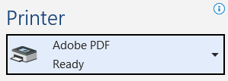



Other Accessibility Tips
Do not use underlined text unless it’s a link
Saving to PDF format
Do not use File > Print
to create a PDF
Use File > Save As > PDF
Notes:
Sometimes people will underline text for emphasis. Do not use underlined text unless it’s a link.
It is common to convert documents to PDF format. When doing so, do not use File > Print to create a PDF
Using file – print creates an untagged PDF document. Untagged means all the underlying document structure and alternative text information is removed.
Instead, Use File > Save As > PDF
Or Acrobat – Create PDF

Slide 36
Other Accessibility Tips
First, ask yourself, "Does this have to be a document?"
A Document is Forever
Post a document on your site and anyone can download it.
It become tricky when posting a new version, or document is deleted.
Users might continue to use old versions.
Include clear version numbers or dates in updated document
Reasons for a document or PDF
Primary purpose: Printing or printing in a precise layout (brochure or form)
You are offering the document as a reusable template.
The content is exceptionally long
(Even manuals can become webpage content!)
Benefits as webpage content
Easier to apply accessibility guidelines
Predictable, consistent user experience
Easily responsive to different screen sizes
Quicker to load
Notes:
Now that we’ve covered the ways to make a document accessible, let’s not forget to evaluate whether content should be a document in the first place.
Reasons you might offer information as a document or PDF
You are offering the document as a reusable template.
Primary purpose is for printing or printing in a precise layout, like a brochure or a form.
The content is exceptionally long like a manual.
(Even manuals can become webpage content as we have scene several agencies do!)
Benefits of website content
Easier to make accessible
Predictable, consistent user experience
Responsive to different screen sizes
Easier to apply accessibility guidelines
Quicker to load
A Document is Forever
Post a document on your site and anyone can download it.
It become tricky when posting a new version, or document is deleted.
Users might continue to use old versions.
Ensure version numbers or dates are clearly stated in documents that are updated over time.
A workflow resource will be available for determining whether content should be a document or webpage.

Slide 37
Module 5
Image Accessibility

Slide 38
Document Accessibility Features
Alternative Text (“Alt Text”)
Types of Images
Use of Color (See Module 4 for Color Contrast)
Keep Complex Images (Data Visualizations) Understandable
Tips Specific to Charts and Graphs
Notes:
Alternative Text (“Alt Text”)
Types of Images
Use of Color
Refer to Module 4 document accessibility for an introduction to color contrast
Keep Complex Images (Data Visualizations) Understandable
Tips Specific to Charts and Graphs

Slide 39
Types of Images
Informative images: Pictures, photos and illustrations of people, scenery or objects.
Images of text: Logos, some complex images.
Decorative images: Decorative icons, horizontal lines.
Functional images: Image used as a link or button like a print, delete or email icon.
Complex images: Charts, graphs, maps, infographics, dashboards (data visualizations).
Notes:
Before we discuss image accessibility, let’s talk about the types of images you see on Websites and in documents.
Examples include:
Informative images: Pictures, photos and illustrations of people, scenery or objects.
Images of text: Logos, some complex images
Decorative images: Decorative icons, horizontal lines
Functional images: Image used as a link or button like a print, delete or email icon.
Complex images: Charts, graphs, maps, infographics, dashboards (data visualizations)

Slide 40
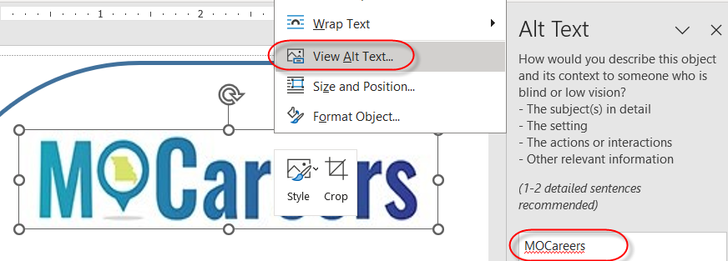
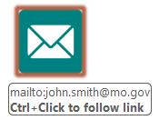
Image Alternative Text (“Alt Text”)
Text alternatives are used by people who do not see the image
Alternative text: Conveys the purpose of an image
  Represents the image function
  Provides an equivalent user experience
Notes:
Next, all image types need to determine their text alternative. What is Text alternatives, also known as “Alt Text”.
Text alternatives are used by people who do not see the image, for example, a screen reader user.
Alternative text: Conveys the purpose of an image
Represents the image function
Provides an equivalent user experience
In this first example, we have a logo, an image with text. We are adding an alternative text by right-clicking the MOCareers image, selecting view alt text and setting the alt text to the wording in the image. In this case, we wouldn’t add the word “logo” to the alt text.
In this second example, we have an icon that we are going to make a link, a functional image. We will evaluate how it is being used. Would the appropriate alt text be “envelope” or “email”? In this case, the alt text would be “email”.

Slide 41
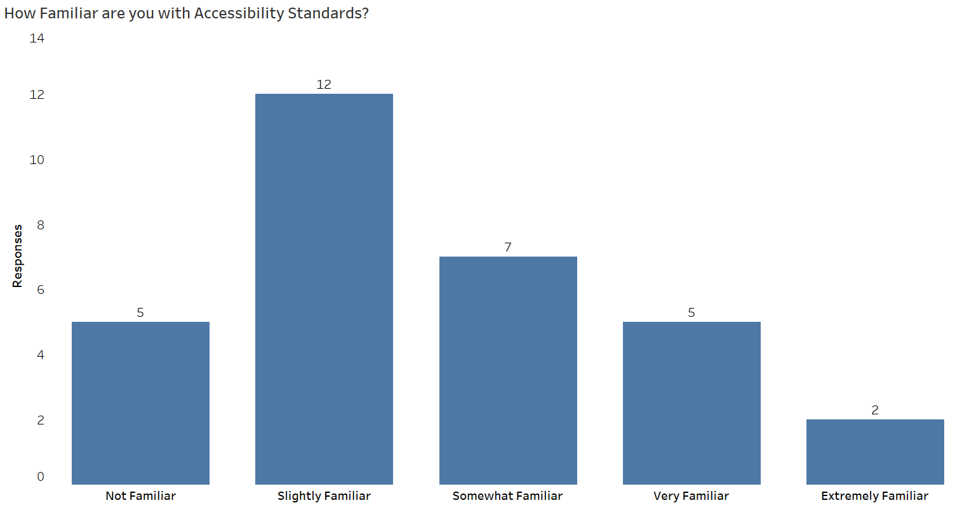
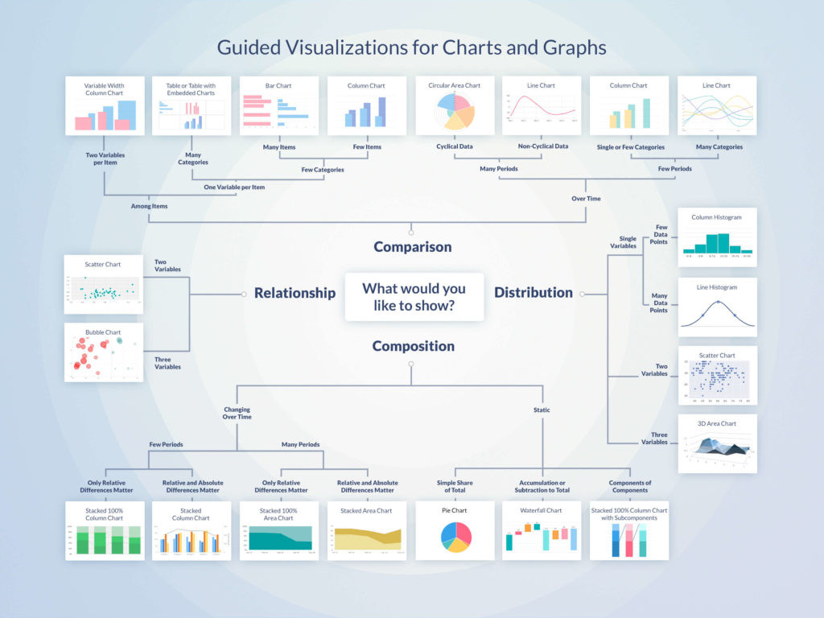
How Long Should Alt Text Be?
150 characters maximum, roughly 30 words
Assistive tech devices have limited reading control within long alt text (can't pause, stop, or easily resume reading if interrupted)
Alt=“Bar chart of how familiar are you with accessibility? 5: not familiar, 12: familiar, 7: somewhat familiar, 5: very familiar, 2: extremely familiar”
Alt=“Flowchart of Guided Visualizations for Charts and Graphs. 1. Composition, 1A. Changing over time, 1A1. Few Periods, 1A1a. Only relative differences matter…”
Notes:
Before we dive into alt text examples, how long can the alt text property be?
Keep alt text at a maximum of 150 characters or roughly 30 words. Many accessibility industry experts recommend this length.
Many assistive technology devices, like screen readers, do have the ability to fully read long alt text. The problems come in with the lack of user control once they start reading it. They cannot pause, stop, or easily resume reading if interrupted like they can with other page or document elements. An easily readable alternative version is the best solution.
In this 5-bar bar chart, we have enough room in the alt text property to describe the information. To give you context, this is a 23 word alt text.
This second example is a complex flowchart visualization explaining how to decide which chart type to use. This will hit 150 characters well before we’ve described what’s going on here.
We will talk more about complex images later in this module.

Slide 42
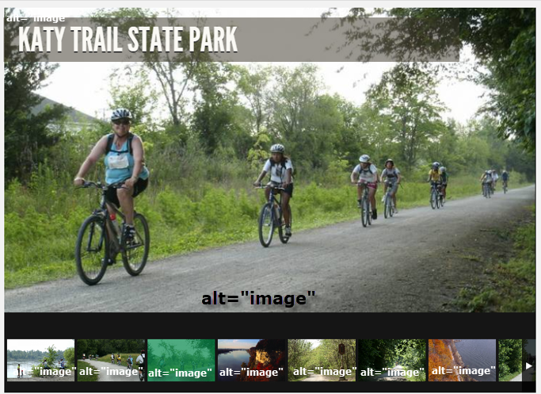
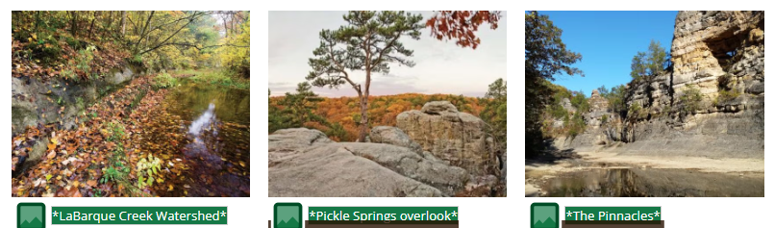
Alt Text: Informative Images
Informative alternative text can be summarized in a short phrase or a few sentences.
Notes:
let’s discuss informative images. The alternative text can be summarized in a short phrase or a few sentences.
In this first example, we have a series of images of a Missouri State Park, showing different features of the park. The alt is set to the word “image” for each image. The correct alt would have been to set them to a brief but descriptive explanation of each state park feature.
In the second image, we have a series of Conservation nature areas with appropriate, descriptive alternative text of their locations Labarque creek watershed pickle springs overlook The pinnacles

Slide 43
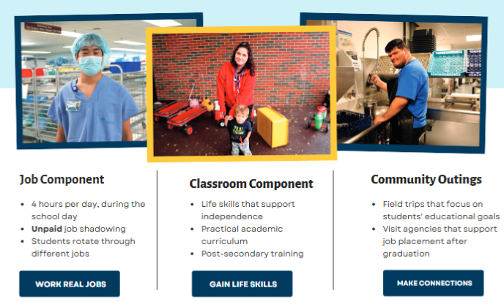
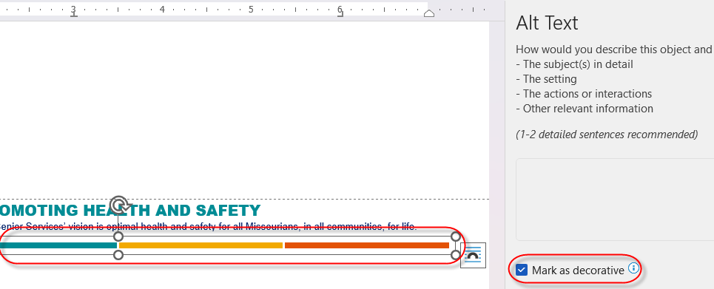
Alt Text: Decorative Images
Image that does not convey meaningful information or to further understand the surrounding content. alt=“”
Using generic stock photos don’t automatically mean decorative image
Review how the image is being used. Don’t indicate an image as decorative because you are unsure what it should include.
Notes:
Let’s explore another image type.
In some cases, images are used purely for decoration. They do not provide additional or supporting information for the surrounding text.. In this first example, There is a colorful horizontal line at the bottom of the page. These do not require alternative text. You will right-click the image, and check the “mark as decorative” option.
Also, when using stock photos (like a photo subscription service), don’t assume the alt text will be decorative. Review the way the photos are being used. In this second example, this document is explaining different career exploration opportunities. You could apply career type information to the alternative text (for the first image here, “job shadowing in the medical field”)
If you use stock photos, this doesn’t automatically mean to indicate as a decorative image. In the example to the right, looking at the context of the images, you could apply career type information to the alternative text (like, “job shadowing in the medical field”)
Unsure of what alt text should be? Discuss with any staff who helped develop the content.

Slide 44
Alt Text: Complex Images
Graphical representation of information and data, also known as “data visualizations”.
Examples:
Charts
Graphs
Infographics
Workflows
Dashboards
Illustrations
Dynamic/static maps
Notes:
Our last image type, Complex Images
Complex images are graphical representations of information and data, also known as “data visualizations”.
Examples include:
Charts
Graphs
Infographics
Workflows
Dashboards
Illustrations
Dynamic/static maps

Slide 45
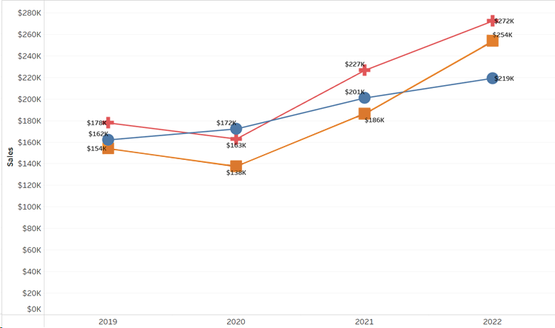
Data Visualization Examples
Charts feature in Excel, Word, PowerPoint
Exported images form Tableau, Microsoft Power BI, etc.
Notes:
Data Viz examples
Here we have a 5-bar bar chart and a 3-line line chart
Excel Charts,
Exported images from Tableau, Microsoft Power BI, etc.

Slide 46
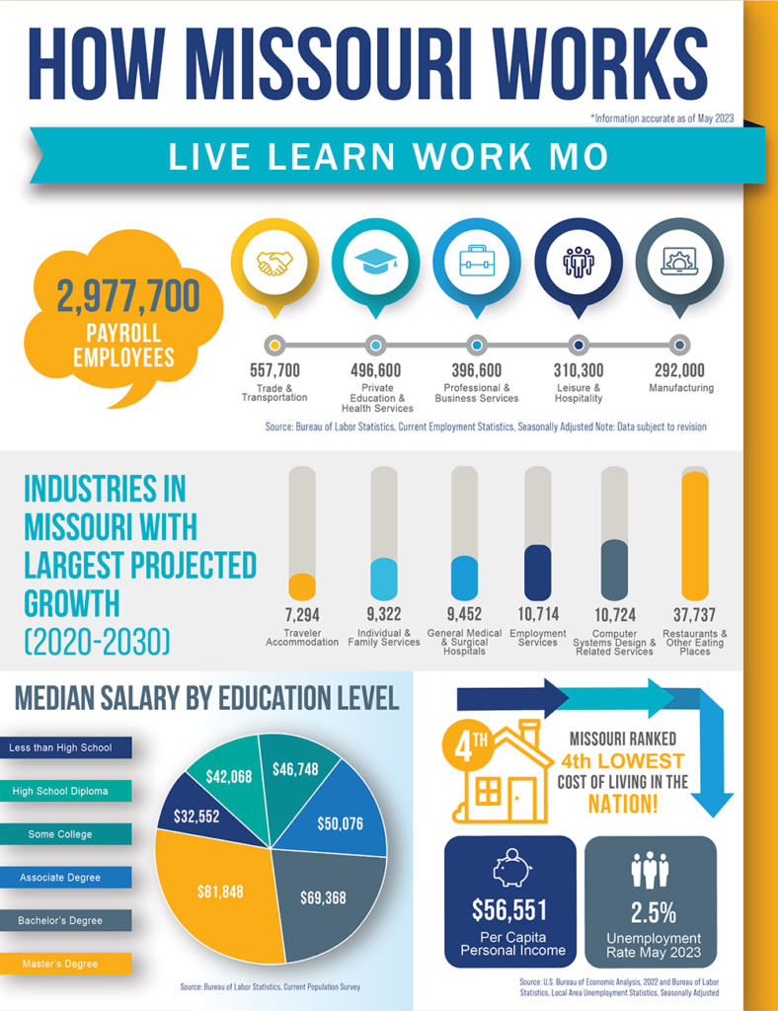
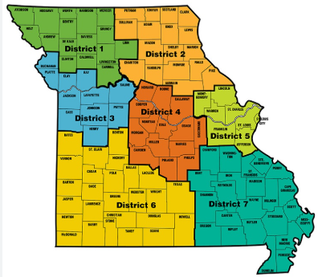
Data Visualization Examples
Infographic or static map created in design software such as Adobe InDesign
Interactive maps from software like ArcGIS or Google Maps
Notes:
To the left we have an
Infographic or dashboard of various data elements combined into one image. To the right a static regional map. This type of imagery can be created in tools such as Adobe InDesign
There are also Interactive maps created in software like ARC GIS or Google Maps. Sometimes these are exported and incorporated into other content.

Slide 47

Determine What to Include in Data Visualization Alt Text
If the information is partially described within the surrounding text, alt text should include the portion not described and refer to the remaining text location.
If the information is fully described within the surrounding text, alt text should refer to the existing text description location.
Notes:
Let’s talk about how to Determine What to Include in Complex Data Visualization Alt Text
If the information is partially described within the surrounding text, alt text should include the portion not described and refer to the remaining text location.
If the information is fully described within the surrounding text, alt text should refer to the existing text description location.
In the example to the right, we have an infographic with the text version displayed to the left of the image. In this case, the alt text will refer to the text on the page.

Slide 48

Determine What to Include in Data Visualization Alt Text
If the full text cannot fit within the alt text, use one of the below options:
Place the full text (data table, text outline, etc.) above or below the image. Alt text should refer to the text location.
Place the full text on another page or other document and link to it underneath the image. Alt text should reference the link.
Place the full text at the end of the document, clearly labeled. Alt text should reference the location.
Notes:
In some cases, alt text equivalent will not fit in 150 characters.
3. If the full text cannot fit within the alt text, use one of the below options. This gives you some flexibility to see what is best or easiest to implement.
Place the full text (data table, text outline, etc.) above or below the image. Alt text should refer to the text location.
Place the full text on another page or other document and link to it underneath the image. Alt text should reference the link.
Place the full text at the end of the document, clearly labeled. Alt text should reference the location.
In this example to the right, we have referenced the alternative version at the end of the PowerPoint presentation.

Slide 49
Alt Text Examples – Graphs & Charts
Incorporate data summaries into the alt text.
Format: “(Chart type) of (type of data) where (reason for including chart)”
Alt=“Bar graph of favorite cereals by vote. Life 6 votes, Cornflakes 4 votes, Kix 3 votes, Cheerios 2 votes.” (full text fits within alt text)
Alt=”Line graph of average student grades over time, where grades improve gradually over the semester. Refer to the data table which follows.”
Alt=”Line graph of number of bananas sold per day in the last year where the winter months have more banana sales. Refer to the labeled data table at the end of this presentation.”
Notes:
Alt Text Examples – Flowcharts, Organizational Charts and Infographics
Incorporate data summaries into the alt text.
Format: “(Chart type) of (type of data) where (reason for including chart)”
Alt=“Bar graph of favorite cereals by vote. Life 6 votes, Cornflakes 4 votes, Kix 3 votes, Cheerios 2 votes.” (full text fits within alt text)
Alt=”Line graph of average student grades over time, where grades improve gradually over the semester. Refer to the data table which follows.”
Alt=”Line graph of number of bananas sold per day in the last year where the winter months have more banana sales. Refer to the labeled data table at the end of this presentation.”

Slide 50
Alt Text Examples – Flowcharts, Organizational Charts and Infographics
Alt=”Organizational chart of Agency Human Resources staff. Refer to the outline which follows.”
Alt=”Flowchart to determine whether content should be a PDF document or a webpage. Refer to the linked outline which follows.”
Alt=”Infographic of tourism impact facts and figures across Missouri, 2025. Refer to the linked details which follow.”
Notes:
Alt Text Examples – Flowcharts, Organizational Charts and Infographics
Alt=”Organizational chart of Agency Human Resources staff. Refer to the outline which follows.”
Alt=”Flowchart to determine whether content should be a PDF document or a webpage. Refer to the linked outline which follows.”
Alt=”Infographic of tourism impact facts and figures across Missouri, 2025. Refer to the linked details which follow.”

Slide 51
Alt Text Examples – Static Directional and Regional Maps
Static Directional Map:
Alt=”Map of the course for a marathon. Start at the intersection of Jefferson St. and Stadium Dr. Make the second right onto Jackson Street. Turn right at the fifth intersection.”
Static Regional Map:
Alt=”Map of Missouri career centers by region. Refer to the region dropdown selection which follows”
Notes:
Alt Text Examples – Static Directional and Regional Maps
Alt=”Map of the course for a marathon. Start at the intersection of Jefferson St. and Stadium Dr. Make the second right onto Jackson Street. Turn right at the fifth intersection.”
Alt=”Map of Missouri career centers by region. Refer to the region dropdown selection which follows”

Slide 52



Use of Color
Do not rely on color to convey information.
If color-coding information, use color plus another element to get your message across
Shapes, patterns, numbers, text, etc.
Original
Red-Green Blindness
Full Color Blindness
Notes:
Do not rely on color to convey information.
If color-coding information, use color plus another element to get your message across.
This second element could be something like shapes, patterns, numbers, text, etc.
In this example, we first have bar charts where yes=green, no=red and blue=maybe.
Red-Green color blindness, the most common, note how the red actually turns to green.
Full color blindness, there is very little difference in the color segments.
We could have made this chart accessible by adding a pattern to each color segment and outline each bar with a thin black line.
Another option would be to overlay the numeric data on each color segment with contrasting text.

Slide 53
Use of Color
Determine if using multiple colors is meaningful. If meaningful, use no more than 7 colors to reduce cognitive load.
Color meaning: Keep color symbolism in mind
          Western societies typically have higher regard for blue over yellow, red sometimes has negative symbolism.
          Eastern societies prize the color yellow and don’t see red as alarming.
Use neutral and consistent backgrounds when using color.
Notes:
When deciding to use multiple colors in your chart, Determine if using them is meaningful. If meaningful, use no more than 7 colors to reduce cognitive load.
Also be aware of color meaning and symbolism.
For example: Western societies typically have higher regard for blue over yellow, red sometimes has negative symbolism.
Eastern societies prize the color yellow and don’t see red as alarming.
Keep your backgrounds neutral and consistent.

Slide 54
Keep Visualizations Understandable
Use plain language (6th-8th grade reading level). Take advantage of the Editor feature in MS Word.
Create simple, easy to understand titles to describe your visualizations
Use 11 pt. font or larger, sanserif fonts like Tahoma or Verdana
Don’t use unnecessary words and abbreviations
Don’t overload, balance with whitespace
Notes:
Keep Visualizations Understandable
We talked about this in Module 4 when creating documents. The same applies for complex images.
Use plain language (6th-8th grade reading level). Take advantage of the Editor feature in MS Word
Create simple, easy to understand titles to describe your visualizations
Use 11 pt. font or larger, sanserif fonts like Tahoma or Verdana
Don’t use unnecessary words and abbreviations
Don’t overload, balance with whitespace

Slide 55


Charts and Graphs – Choose an Appropriate Type
Bars/Stacked Bars – Quantities across categories. They provide clear distinctions between data points and are generally easy to interpret.
Line/Area Graphs – Patterns over time.
Pie/Donut Charts – Proportions within a whole. They can be challenging for some users to interpret accurately, especially when segments are similar in size. Stacked bar charts accomplish the same goal.
Notes:
When it comes to Charts and Graphs – Choose an Appropriate Type
You have the ability to create your own charts through the chart feature in Microsoft Office tools like Excel, Word and PowerPoint.
These are the top three recommended chart types:
Bars/Stacked Bars – Quantities across categories. They provide clear distinctions between data points and are generally easy to interpret.
Line/Area Graphs – Patterns over time.
Pie/Donut Charts – Proportions within a whole. They can be challenging for some users to interpret accurately, especially when segments are similar in size. Stacked bar charts accomplish the same goal.

Slide 56

Charts and Graphs – Axes, Shapes and Labels
Y axes should almost always start at zero
Certain cases should truncate (trim) axes
Use both shapes and labels that are clear and distinctive
Redundant encoding is key! (i.e., specific point along a line and numeric labels)
Notes:
After you choose your chart type, what other things should you think about to make your chart understandable to the widest possible audience?
The Y axes should almost always start at zero
Note that in certain cases, truncate (trim) axes
Let’s look at an example to the left, setting the Y axes to zero does not make sense for temperature numbers, making the trend information vague. Focusing in like a lens between 50-60 degrees gives more clarity to the trend data.
Use both shapes and labels that are clear and distinctive
Redundant encoding is key! What is redundant encoding? In this line chart example to the right, specific points are plotted along the line as well as labeling the point numerically

Slide 57

Charts & Graphs – Solutions for
Non-Text Contrast
Example 1: Bar Chart
In the following example, we have a 3-color bar chart. When testing the contrast, the blue, orange and gray colors don’t pass 3:1 contrast with the background (white).
Notes:
In module 4, we discussed the importance of color contrast.
The following few slides give examples of how to handle color contrast specifically within charts and graphs.
Example 1: Bar Chart
In the following example, we have a 3-color bar chart. When testing the contrast, the blue, orange and gray colors don’t pass 3:1 contrast with the background (white).

Slide 58

Charts & Graphs – Solutions for
Non-Text Contrast
Bar Chart Solution 1: Darken the bars. Darken the three colors till they pass 3:1 contrast with the white background.
Bar Chart Solution 2: Apply a dark outline. Outline each element (bar) in a dark color, like black. The black now becomes the contrast color for each colored bar. See example below.
Notes:
Here are a couple of solutions
Solution 1: Darken the bars. Darken the three colors till they pass 3:1 contrast with the white background.
Solution 2: Apply a dark outline. Outline each element (bar) in a dark color, like black. The black now becomes the contrast color for each colored bar. See example below.

Slide 59

Charts & Graphs – Solutions for
Non-Text Contrast
Example 2: Pie Chart
In the case of pie charts and maps, the contrast check involves testing adjoining elements (or elements that touch each other).
Pie Chart Solution 1: Alternate the contrast in each pie piece. You’ll notice in the following 4-color pie chart, the pie pieces alternate with light and dark colors. The adjoining pie pieces are tested and they pass 3:1 color contrast.
Notes:
Example 2: Pie Chart
In the case of pie charts and maps, the contrast check involves testing adjoining elements (or elements that touch each other).
Pie Chart Solution 1: Alternate the contrast in each pie piece. You’ll notice in the following 4-color pie chart, the pie pieces alternate with light and dark colors. The adjoining pie pieces are tested and they pass 3:1 color contrast.

Slide 60

Charts & Graphs – Solutions for
Non-Text Contrast
Pie Chart Solution 2: Apply a dark outline. In the following 4-color pie chart, the color contrast does not vary. Instead of changing the pie piece colors, a black outline was applied to each pie piece. All pie piece colors now pass the 3:1 contrast against the black outline.
Notes:
Pie Chart Solution 2: Apply a dark outline. In the following 4-color pie chart, the color contrast does not vary. Instead of changing the pie piece colors, a black outline was applied to each pie piece. All pie piece colors now pass the 3:1 contrast against the black outline.

Slide 61
Module 6
Summary, Next Steps and Being an Accessibility Champion

Slide 62
Web Accessibility Benefits
Improved User Experience
Accessible websites are easier to use for people with permanent disabilities as well as temporary and situational challenges.
Search Engine Optimization (SEO)
Accessible sites perform better in search engines, resulting in content that is easier to find.
Positive Business Reputation
Organizations that prioritize accessibility are often seen as more socially responsible, with a commitment to inclusion and equal opportunity.
Notes:
Web accessibility provides huge benefits for Missouri citizens and fellow state employees.
These benefits are:
Improved User Experience
Accessible websites are easier to use for people with permanent disabilities as well as temporary and situational challenges.
Search Engine Optimization (SEO)
Accessible sites perform better in search engines, resulting in content that is easier to find.
Positive Business Reputation
Organizations that prioritize accessibility are often seen as more socially responsible, with a commitment to inclusion and equal opportunity.

Slide 63

Web Accessibility Benefits
Privacy and Security
Some compare accessibility’s importance to that of privacy and security. It is not like privacy and security.
Web accessibility is privacy and security.
Consider examples like banking, shopping, and accessing medical information.
Inaccessible technology may force individuals with disabilities to reveal personal information.
An accessible experience ensures independence — and the human right to privacy and security.
Notes:
Last but not least, the benefit of Privacy and Security.
To highlight the importance of accessibility, there are some who compare it at the level of privacy and security. There are many laws, including state standards that protect these right.
It is not like privacy and security….Web accessibility is privacy and security.
Consider situations like, when you log in to your banking information, perform online shopping transactions accessing your financial accounts or accessing your online medical records. Inaccessible technology may force individuals with disabilities to reveal personal information with others and in some cases, anyone listening nearby.
An accessible experience ensures independence — and the human right to privacy and security

Slide 64

Recap: What is Web Accessibility?
The practice of creating usable
and understandable websites,
applications and digital documents
for ALL people.
Notes:
Let’s go back and look at that definition again.
Web Accessibility, the practice of creating usable and understandable websites, applications and digital documents for ALL people.
We hope you now have a better understanding of what that means and can go back and incorporate these lessons into your daily work. This allows accessibility to be built into the work you do from the very beginning.

Slide 65
How Can You Play a Part in Web Accessibility?
Be an Accessibility Champion!
If you notice accessibility issues:
Fix as a content creator, or
Report content you see.
Typically, you can report issues through
your agency’s Communications office.
Notes:
How Can You Play a Part
in Web Accessibility? - be an accessibility champion.
Now that you have a better understanding of what accessibility is, who it impacts and some guidance on how to make your content accessible, let’s put it into action.
If you notice accessibility issues:
Fix content you have created using the information you have learned, or
If you notice something, say something. Report content you see to be fixed.
Typically, you can report issues through your agency’s Communications office.

Slide 66
Accessibility:
Progress, Not Perfection
One step at a time.
One piece of content at a time.
PROGRESS is what’s important, not perfection.
Notes:
Accessibility:
Progress, Not Perfection
Congratulations! Completing this course hopefully provided you both an understanding of the why behind accessibility and some knowledge to implement it.
But remember: take it one piece of content at a time. This will create momentum and an integration of what you’ve learned into your daily work and routine.
PROGRESS is what’s important, not perfection.

Slide 67
Next Steps! Thank you.
State Employee Web Accessibility Toolkit
Includes:
Information about web accessibility law
Checklists and guides for Microsoft documents, PDF, plain language, etc.
Effective accessible content planning
Image accessibility references
Color contrast references
Expand accessibility skills – advanced PDF accessibility and other topics
Copy of this presentation
Toolkit link is included in the MOVERS Learn course description
Notes:
We want to leave you with a resource site that will give you the tools and references to continue this important work.
The state employee accessibility toolkit, which includes information about:
Web accessibility law
Checklists and guides for Microsoft documents, PDF, plain language, etc.
Effective accessible content planning
Image accessibility references
Color contrast references
Expanding accessibility skills through other courses like advanced PDF accessibility and other topics
Copy of this presentation
This toolkit link is included in the MOVERS Learn course description

Slide 68
Thank YOU for your time
You become an important part of the state’s commitment to inclusion
and equal opportunity.
Result: A positive impact to both citizens and state employees.
Agency Digital Accessibility Questions?
Contact your agency digital accessibility coordinator
(see toolkit page)
General Accessibility Questions? oa.digital.accessibility@oa.mo.gov
Notes:
Thank you for your time and commitment in completing this course.
As you go back and incorporate what you’ve learned, you become an important part of the state’s commitment to Inclusion and equal opportunity.
The result is a positive impact to both citizens and state employees, thanks to your work.
If you have further questions about your agency’s digital accessibility, please reach out to your agency’s digital accessibility coordinator. A link is provided on the Accessibility Toolkit page.
For general accessibility questions, please contact oa.digital.accessibility@oa.mo.gov

